Slide 1
Data Science Batch 2020 Introduction
Marlabs

Slide 2
Table of Content
Jobs Trend
Related Data Science Jobs
Skill Sets
Projects Domains
Job Interviews Requirements
Assignments/Projects Requirements
Symbol English
Syllabus (file attached)
Tue, Thur, Sat. (7:OO-8:00pm CST, 9am to 11am CST)

Slide 3
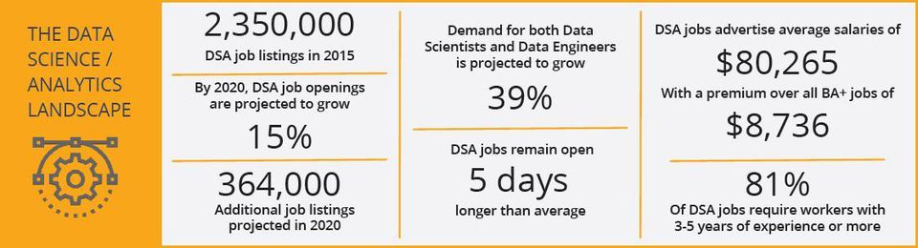
Jobs Trend
IBM Predicts Demand For Data Scientists By 2020 (written in 2017)
DSA jobs: Data Scientist & Analysis jobs
https://www.forbes.com/sites/louiscolumbus/2017/05/13/ibm-predicts-demand-for-data-scientists-will-soar-28-by-2020/#6c65480c7e3b

Slide 4
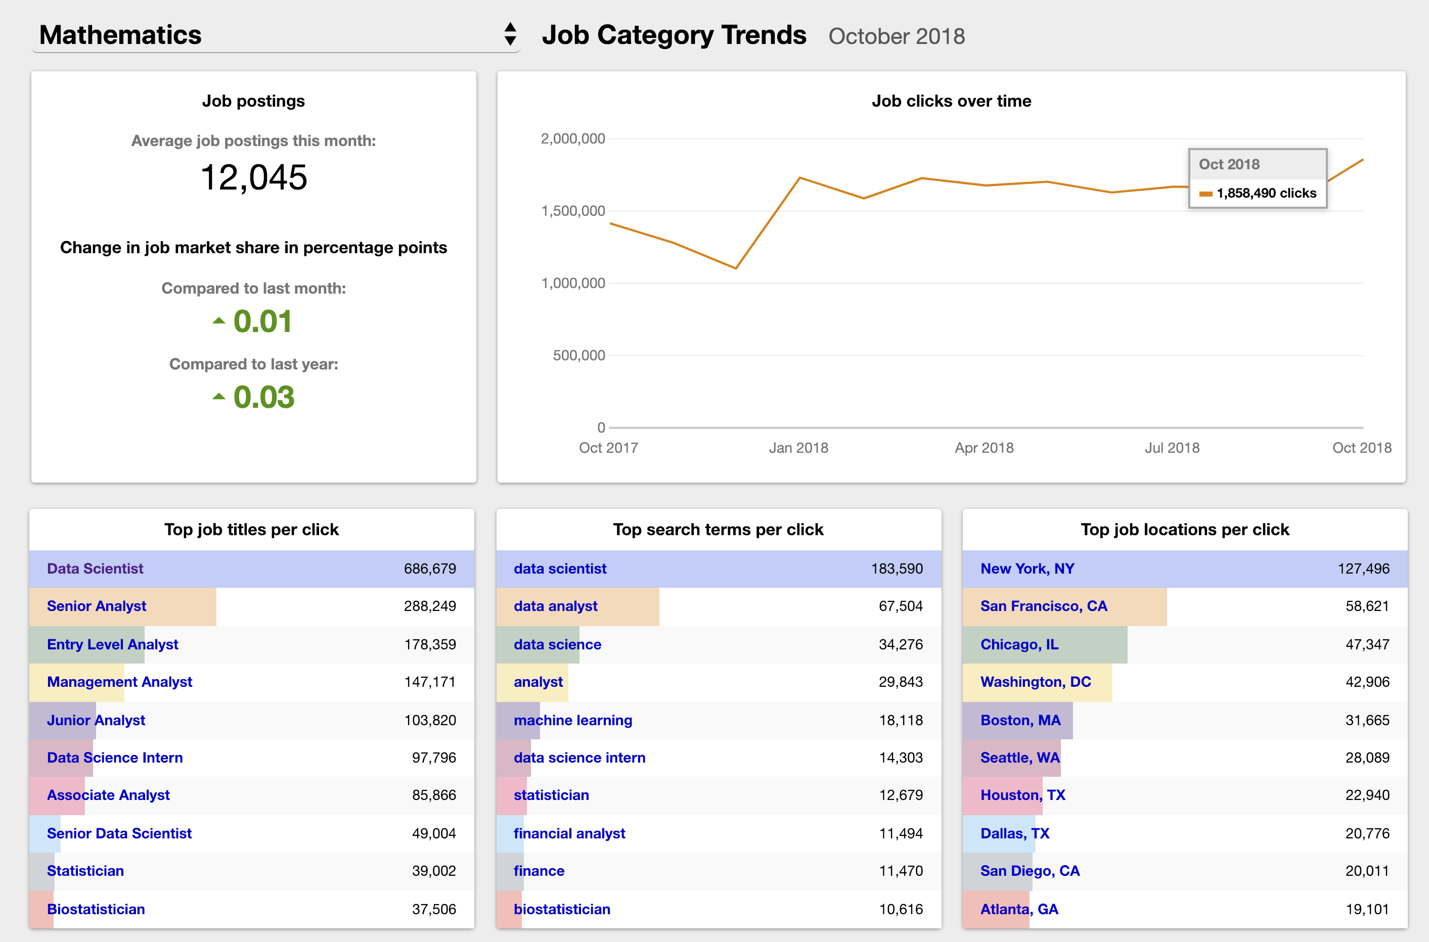
Jobs Trend
https://www.indeed.com/jobtrends/math-category-trends

Slide 5
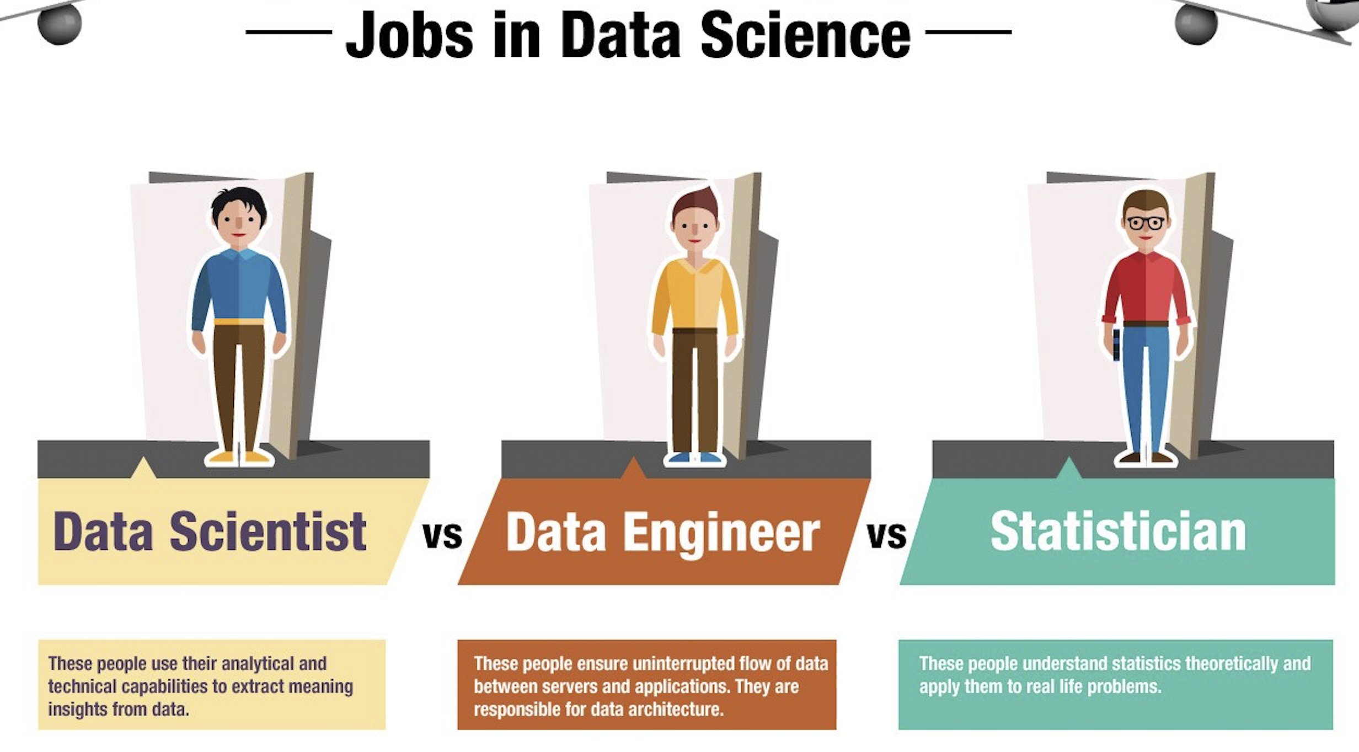
Related Data Science Jobs
Machine Learning Engineer
Data science infrastructure. Data Broker building. Machine Learning pipeline.

Slide 6
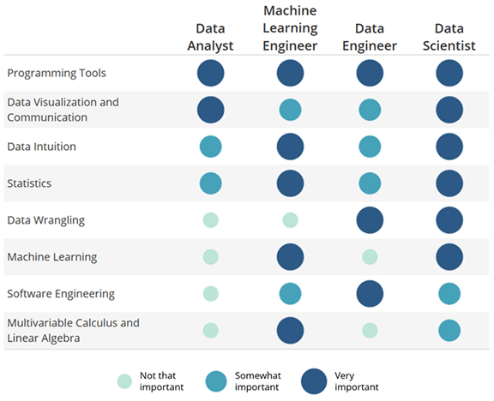

Slide 7

Skill Sets

Slide 8
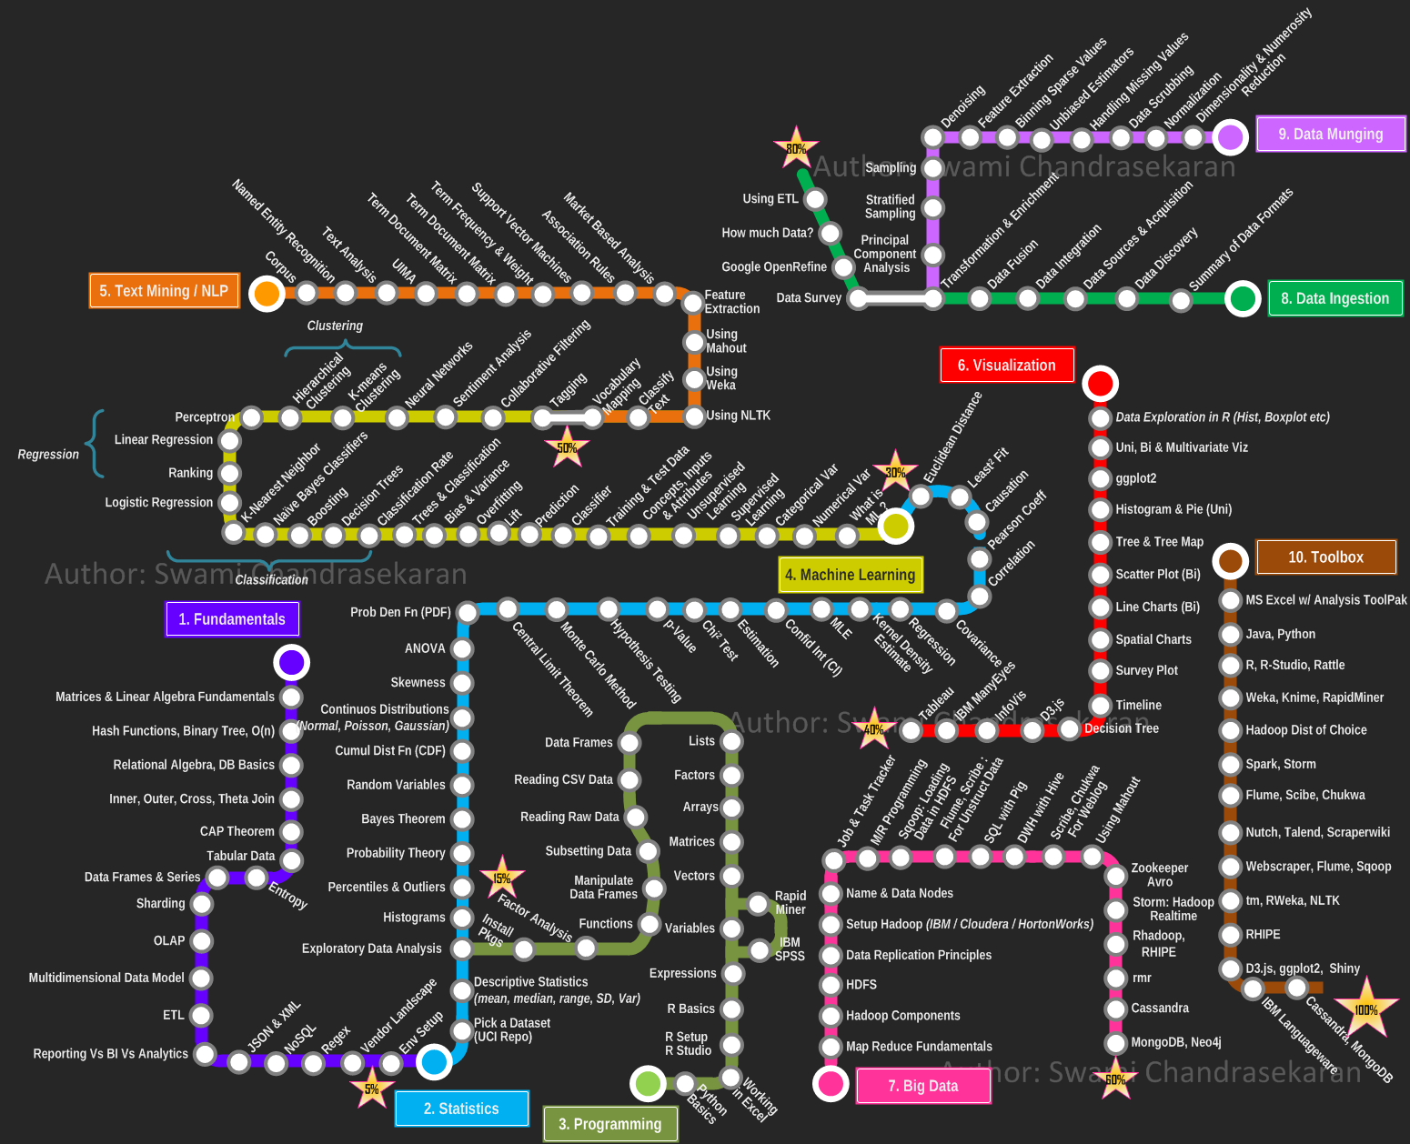

Slide 9
Project Domains
Domain | Data Science Applications
IT | Internet Search
IT, Retail | Digital Advertisements
Entertainment, E-Commerce | Recommendation Systems
Manufacturing, Entertainment | Image Recognition
Entertainment | Gaming
Transportation | Airline Route Planning
Finance | Fraud & Risk Detection
… | …
https://www.analyticsvidhya.com/blog/2015/09/applications-data-science/
https://towardsdatascience.com/turning-fortnite-into-pubg-with-deep-learning-cyclegan-2f9d339dcdb0

Slide 10
Job Interview Requirements
In real life data scientist interviews:
(1) Technical Interview Questions.
ML, DL, Statistics, NLP, Recommendation Sytem, Big Data, Spark, Scala, Infrastructure related, Docker
(2) Projects related.
How did you use the algorithms in your projects?
How did you generate different variables?
If I give you a text dataset, how are you going to start conducting the analysis?
(3) Small project & coding test.
Data science project (Kaggle format)

Slide 11
Job Interview Preparation
Our preparation:
-> Prepare the technical Interviews now. Every class we will use 10-15 minutes pick up 2-3 students to ask the technical questions based on what we learnt from past lessons and some Andrew Ng classes’ questions.
Links:
http://rpubs.com/JDAHAN/ds_interview
https://www.springboard.com/blog/data-science-interview-questions/
https://www.analyticsvidhya.com/blog/2018/06/comprehensive-data-science-machine-learning-interview-guide/
https://www.coursera.org/learn/machine-learning/home/welcome
https://www.coursera.org/specializations/deep-learning?#courses
(2) -> You are going to start doing projects start from second week of training based on the things we have learned.
Links:
https://www.kaggle.com/
(3) -> Python coding practice, R coding practice, SQL coding practice (usually orally describe your code). This part can be covered in our assignments, but you have to practice yourself in your spare time.
Useful links:
https://www.w3schools.com/python/exercise.asp
https://leetcode.com/(easy level is enough)

Slide 12
Assignments Requirements
Please do it yourself on time. It’s a great self-improvement exercise.
No scores or punishment, but I will inform Grace and your recruiter if there’s any delay or mis-behavior.
Please keep in mind: landing a data science related job is our goal.

Slide 13
Symbol English

